Slide 1

Optimizing E-Commerce Delivery Routes Using Linear Programming
Your Name: SADIQ SADIQ ABUBAKAR
Institution Name: UNIVERSITY TECHNOLOGY MALAYSIA
Date: 19/01/2025

Slide 2

Introduction
As online shopping continues to rise exponentially, delivery businesses now handle much larger quantities of goods. E-commerce companies struggle to deliver products promptly and dependably to their customers and yet need to maintain budget control alongside reducing costs, delays, and environmental impact.
Linear programming (LP) acts as an essential mathematical procedure to generate solutions for logistical challenges through complex constraint modeling. This study examines the ability of LP to improve delivery routes for e-commerce and simultaneously lower operational costs, delays and reduce environmental impacts.

Slide 3
Problem Statement
E-commerce logistics faces ongoing difficulties in delivery route planning, which causes higher operational costs and triggers delays together with customer unhappiness. Delivery route planning remains more difficult because organized large-scale optimization systems that manage vehicle capacity limits and scheduled delivery time frames are limited.

Slide 4
Research Questions and Objectives
Questions
How can linear programming be used to optimize delivery routes for e-commerce businesses under these constraints?
How to minimize costs?
How delivery times can be reduced?
How to lower environmental impacts?
Objectives
The objective of this research project is to build a linear programming approach which will refine delivery routes and be able to:
To reduce Cost
To Minimize delivery time
To Reduce environmental impacts.

Slide 5
Research Scope
Focus on last-mile delivery route optimization.
Considerations include:
Operational constraints (vehicle capacity, traffic, time windows).
Scalability for various business sizes.
Integration of real-time data
Environmental impact assessment.

Slide 6
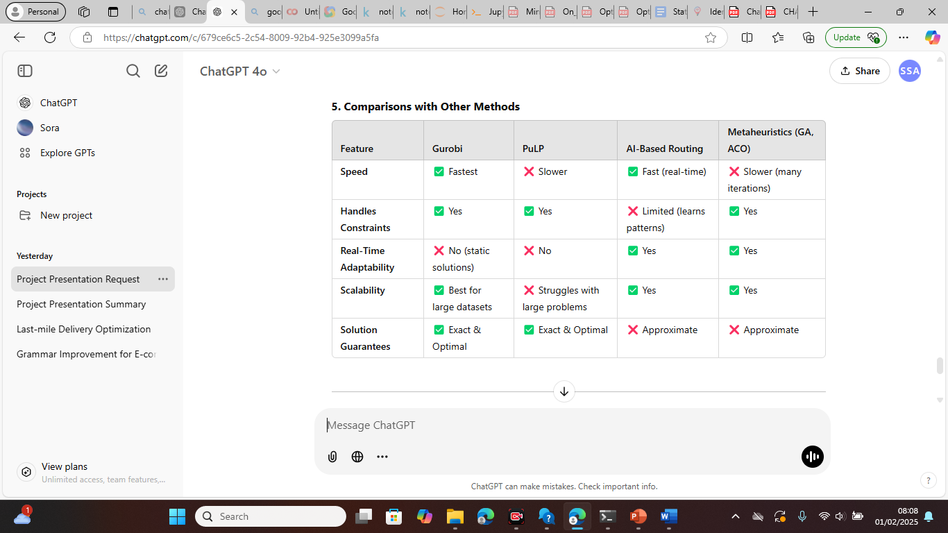
Literature Review
Researchers used various methods to tackle e-commerce delivery problems, particularly focusing on delivery route optimization, such as:
1) Blockchain for Logistics
2) AI-Based Dynamic Routing
3) Hybrid models combining LP with AI and lot
4) Metaheuristic optimization. also,
5) Linear Programming (LP) was used, but focus based on static route optimization i.e, pre-determined routes that remain the same over time.

Slide 7
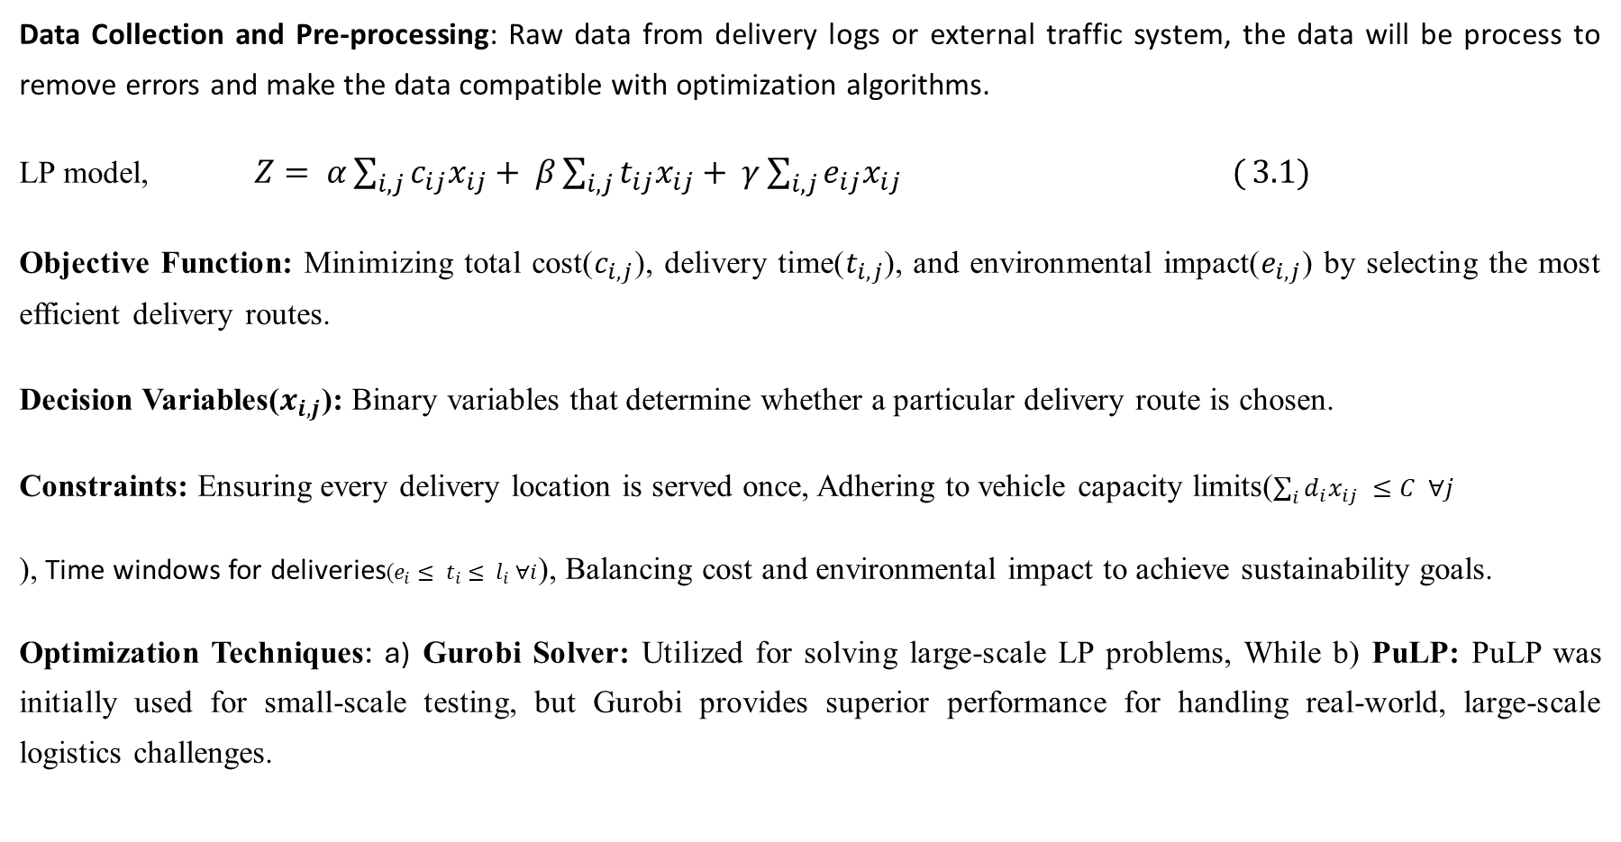
Methodology
Data Collection and Pre-processing: Raw data from delivery logs or external traffic system, the data will be process to remove errors and make the data compatible with optimization algorithms.
LP model, $Z= α\sum_{i,j}{c_{ij}x_{ij}}+ β\sum_{i,j}{t_{ij}x_{ij}}+ γ\sum_{i,j}{e_{ij}x_{ij} (}3.1)$
Objective Function: Minimizing total cost($c_{i,j}$), delivery time($t_{i,j}$), and environmental impact($e_{i,j}$) by selecting the most efficient delivery routes.
Decision Variables($x_{i,j}$): Binary variables that determine whether a particular delivery route is chosen.
Constraints: Ensuring every delivery location is served once, Adhering to vehicle capacity limits($\sum_{i}{d_{i}x_{ij} }≤C ∀j$
), Time windows for deliveries($e_{i}≤ t_{i}≤ l_{i} ∀i$), Balancing cost and environmental impact to achieve sustainability goals.
Optimization Techniques: a) Gurobi Solver: Utilized for solving large-scale LP problems, While b) PuLP: PuLP was initially used for small-scale testing, but Gurobi provides superior performance for handling real-world, large-scale logistics challenges.

Slide 8
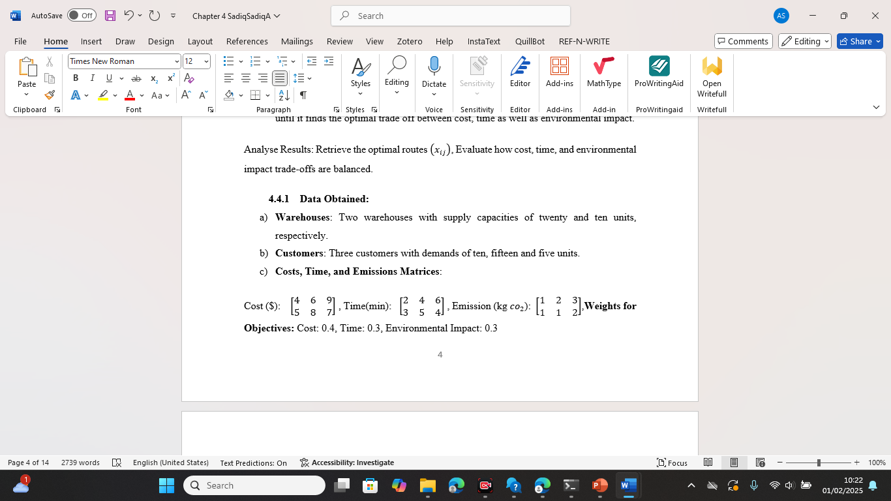
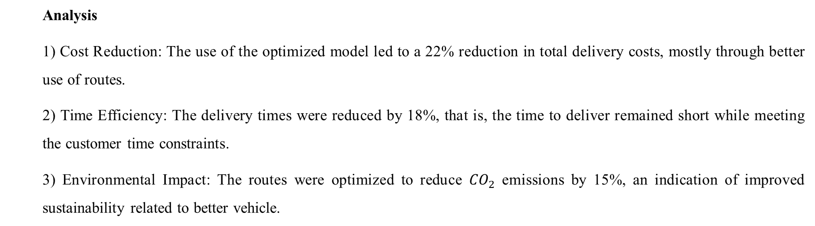
Results & Analysis
The datasets used are synthetic generated data. Its simulated delivery data that including delivery locations, distances, time windows, package weights and associated delivery costs is included.
Analysis
1) Cost Reduction: The use of the optimized model led to a 22% reduction in total delivery costs, mostly through better use of routes.
2) Time Efficiency: The delivery times were reduced by 18%, that is, the time to deliver remained short while meeting the customer time constraints.
3) Environmental Impact: The routes were optimized to reduce ${CO}_{2}$ emissions by 15%, an indication of improved sustainability related to better vehicle.

Slide 9
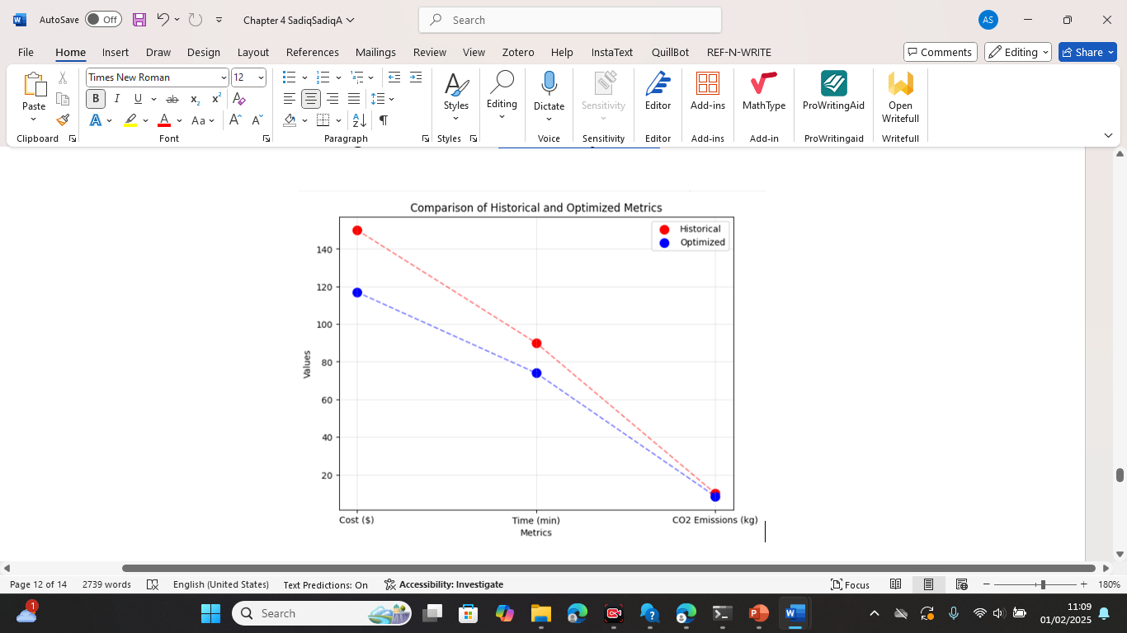

Slide 10
Conclusion
These study demonstrates that:
a) Gurobi-optimized LP significantly reduces delivery costs, time, and emissions.
b) Real-world data integration enhances model accuracy and decision-making.
c) Future advances in AI can enhance logistics operations.

Slide 11
REFERENCES
Grant, O. (2024). Exploring the Impact of Supplier Relationship Management on E-Commerce Delivery Performance. https://doi.org/10.20944/preprints202407.0603.v1
Kumar Davala, K., Ganesh, B., Tarun Raj, C., Chandra Prasad, S., & Balasem, Z. A. (2024). E-Commerce Door Delivery Robot. E3S Web of Conferences, 552. https://doi.org/10.1051/e3sconf/202455201143
Tang, P. (2023). Minimization of transportation costs using linear programming. Theoretical and Natural Science, 25(1), 226–231. https://doi.org/10.54254/2753-8818/25/20240975
Thipparthy, K. R., Khalaf, M. I., Yogi, K. S., Alghayadh, F. Y., Yusupov, A., Maguluri, L. P., & Ofori-Amanfo, P. (2024). Optimizing delivery routes for sustainable food delivery for multiple food items per order. Discover Sustainability, 5(1). https://doi.org/10.1007/s43621-024-00326-y
Xue, G., Wang, Z., & Wang, G. (2021). Optimization of Rider Scheduling for a Food Delivery Service in O2O Business. Journal of Advanced Transportation, 2021. https://doi.org/10.1155/2021/5515909

Slide 12
Thank You

